Slide 1


Slide 2
Markup – Intro to HTML

Slide 3
Overview
In this module you will learn:
Web page construction
Basic HTML tags
HTML5

Slide 4
Web Pages
We can create webpages using a simple text editor. Feel free to use your own editor (Textpad, Notepad)
We need 2 tools to create webpages:
an editor
a browser

Slide 5
First HTML Page
Open your editor
Hopefully, this is the ugliest page you ever create! Let’s start by just writing in some text:
Hello World!
Save this file as your firstname.html.
Preview in Firefox

Slide 6

First HTML Page
HTML is coded by using “tags” or “elements”. Most tags need an open and close tag. So let’s add a tag to our demo:
The <h1> tag has properties associated with it. So when the browser sees an <h1> tag, it knows to make the text a certain size and weight.
Preview in the browser again and notice the changes.

Slide 7
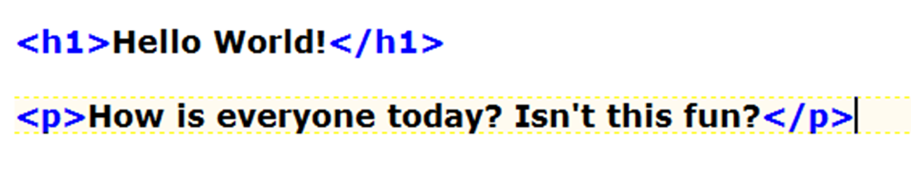
First HTML Page
Let’s add another tag:
The <p> stands for paragraph. When the browser sees the <p> tag it knows that the text inside should be treated as a paragraph, and add a line above and below.
Preview in the browser again

Slide 8
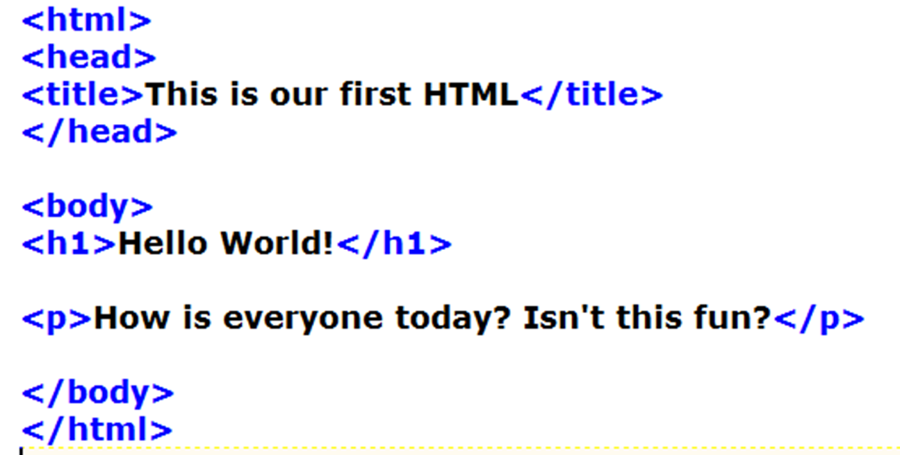
First HTML Page
Let’s add some information to our page.

Slide 9
First HTML Page
The <html> tag is used to identify the document
The <head> tag is used to hold items such as title
The <body> tag holds the information which will be displayed in the browser window
All tags must be closed (as with XML)
Now we’ve added some info about our page, making it easier for search engines to find our page. Search engines (primarily Google) will look at your title and the first text of the document for searching.

Slide 10
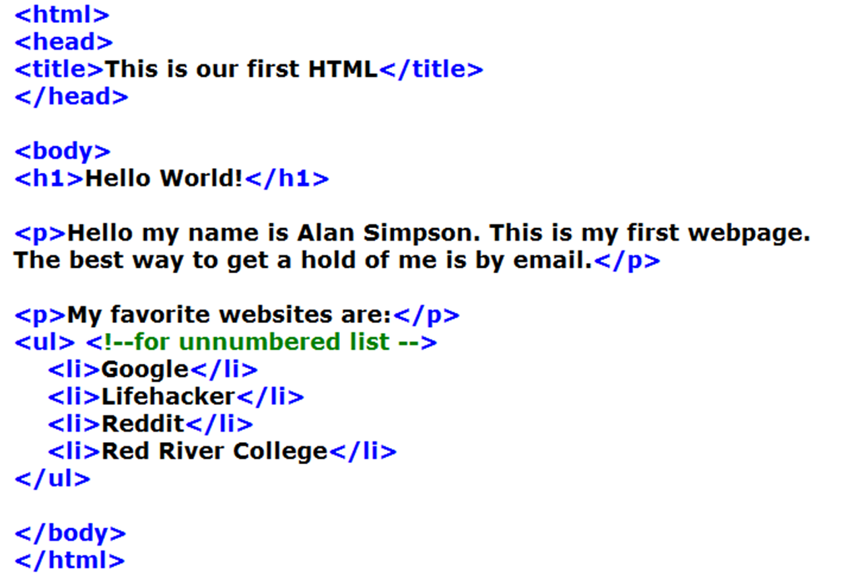
First HTML Page
Continue to add to your document

Slide 11
First HTML Page
The <ol> tag creates a ordered html list (numbered)
The <ul> tag creates a unordered list (bullets)
The <li> tag is list item
Comments begin with <!—
Comments end with -->

Slide 12
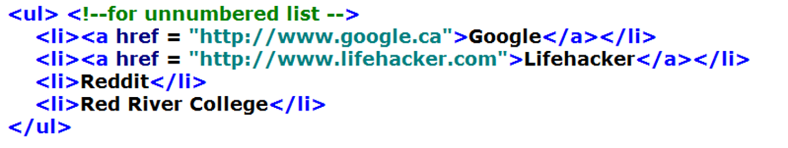
First HTML Page
Remember that nice list of websites we made? What would make them more useful? If we put links into our list, the user could click on the links to our sites.

Slide 13
First HTML Page
The <a> tag defines a link
href specifies the destination address and will always be enclosed in quotes
The link text is displayed on the browser page

Slide 14
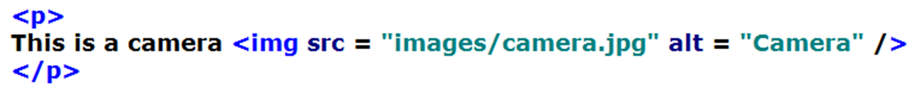
Images Links
Now we’ll add an image to our page.
The <img> tag will not have a closing tag. Instead it uses />. It will only contain attributes
src = specifies the link to the image (can be a relative or absolute address)
alt specifies alternate text for the image

Slide 15
Email Links
Now lets add an email link
Again the <a> tag is used and the href is the email address
A text link can be used to display text on the page

Slide 16
Heading Links
While we’re here, let’s quickly add an <h2> element to the end of our code.
There are six heading tags (h1 to h6) each having predefined sizes and weights
The <h1> tag should be used for main headings followed by <h2> to <h6>

Slide 17
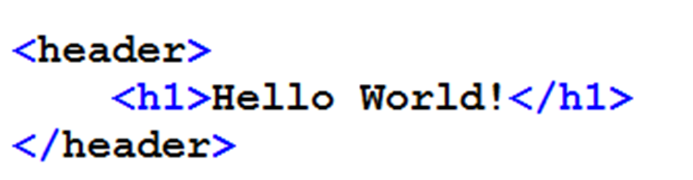
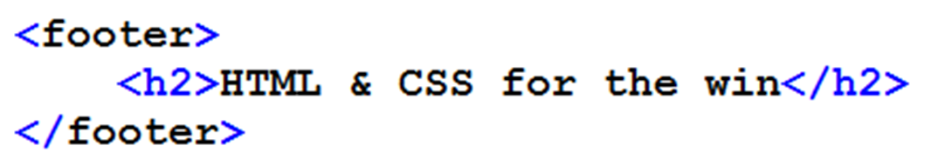
HTML5
Add these elements:
Refresh in the browser. Notice anything? Good. They did nothing but what they do is describe our content better, also giving us more control with CSS, which we’ll get to in a minute.

Slide 18
HTML5 Semantic Elements
New to HTML5 are semantic elements; elements that by their name will describe their content accurately. Let’s add a few of these elements to our page.
Two elements that are related to each other are the <header> and <footer> elements. They’re used to contain content in the header and footer area of a webpage. Let’s add them to ours.

Slide 19
HTML5
Let’s add one more. The <section> element is used for, yup, you guessed it; sections of the webpage. One common technique is, along with a header and a footer, to have a content section.

